Slide 1

Stock comparison app
By: Asha Lee

Slide 2
Project Objectives
Compare the performance of three stocks using financial metrics and technical indicators.
Provide users with a flexible and interactive interface to select stocks and time periods.
Use professional data sources like WRDS for high-quality, reliable data.

Slide 3
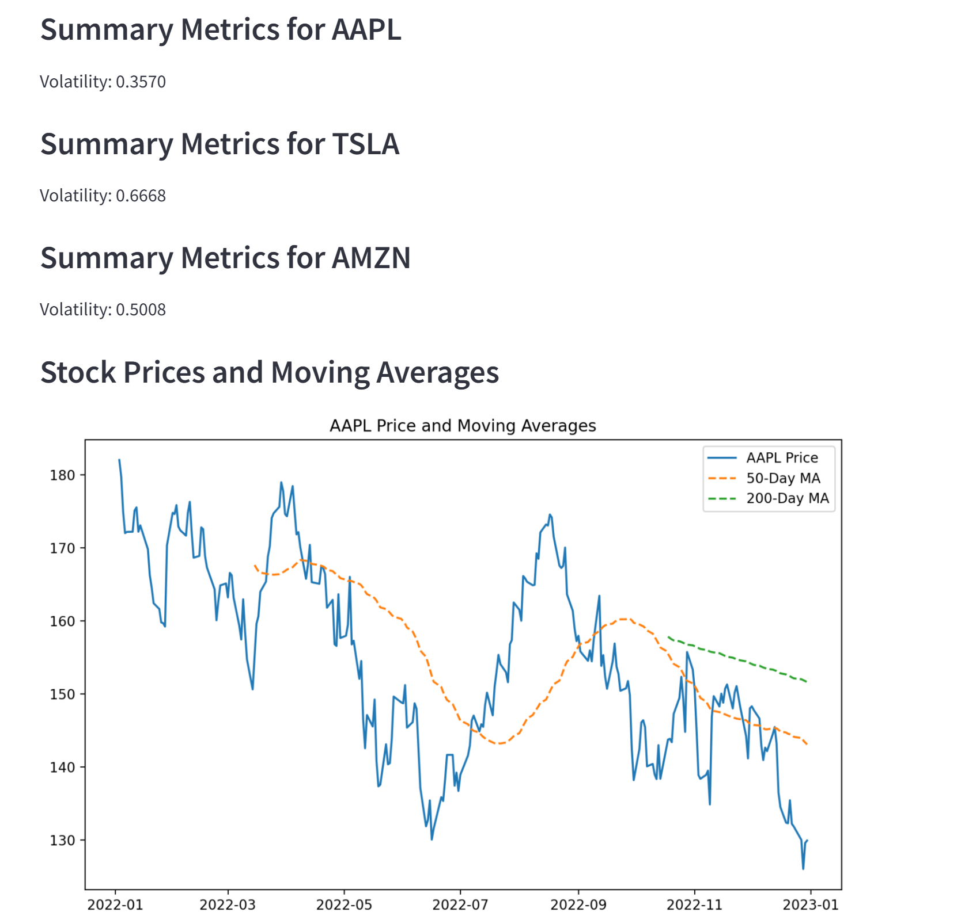
Features of the Project
User interface to input stock tickers and time ranges.
Data fetched from WRDS, ensuring accuracy.
Key metrics: Moving Averages (50, 200 days), RSI, Volatility.
Visualizations: Price trends, technical indicators, and bar charts.

Slide 4
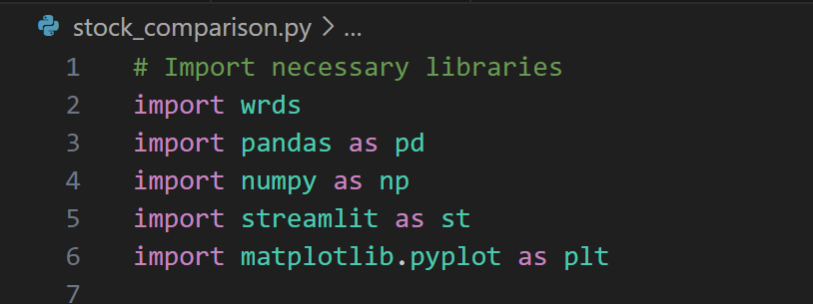
Technical Details
Python Libraries:
WRDS: For data retrieval from CRSP and stocknames databases.
Pandas, NumPy: For data manipulation and calculations.
Matplotlib: For visualizations.
Streamlit: For creating an interactive user interface.

Slide 5
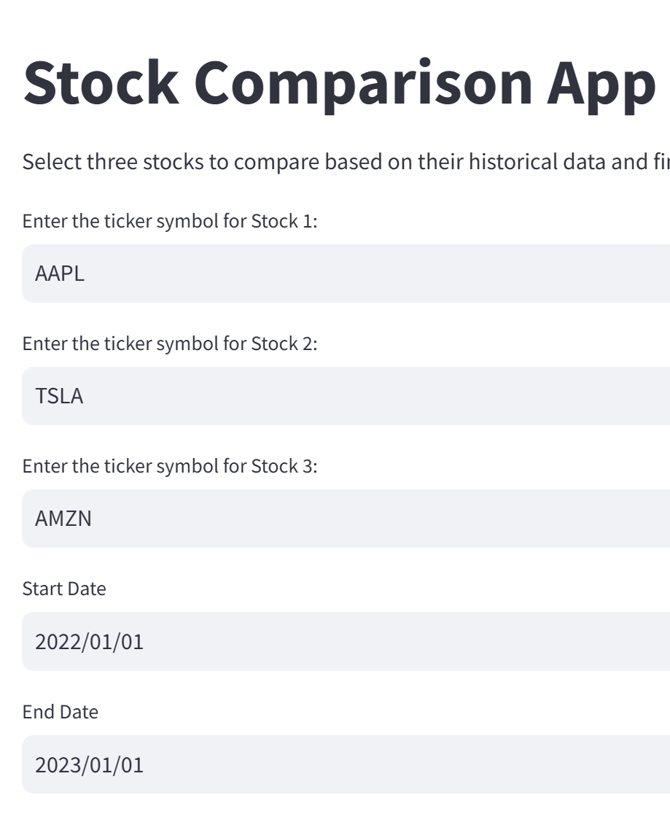
Workflow
1. User selects three stock tickers and date range.
2. Fetch data from WRDS (using CRSP and stocknames).
3. Calculate key metrics: Moving Averages, RSI, Volatility.
4. Visualize data and metrics (line charts, bar charts).
5. Compare stocks and make recommendations.

Slide 6
Benefits of the Project
Enables informed investment decisions.
Leverages professional data sources (WRDS).
Provides flexibility and interactivity to compare any stocks.
Enhances skills in Python, data analysis, and visualization.

Slide 7
Conclusion
This project demonstrates how Python can be used for financial analysis.
WRDS ensures high-quality data for accurate stock comparisons.
Interactive features make it a practical tool for investors and learners.

